Slide 1

Scrape Art
www.artcyclopedia.com
Scraping ArtCyclopedia.com
Danli Zeng | Background Image by Frank Stella

Slide 2
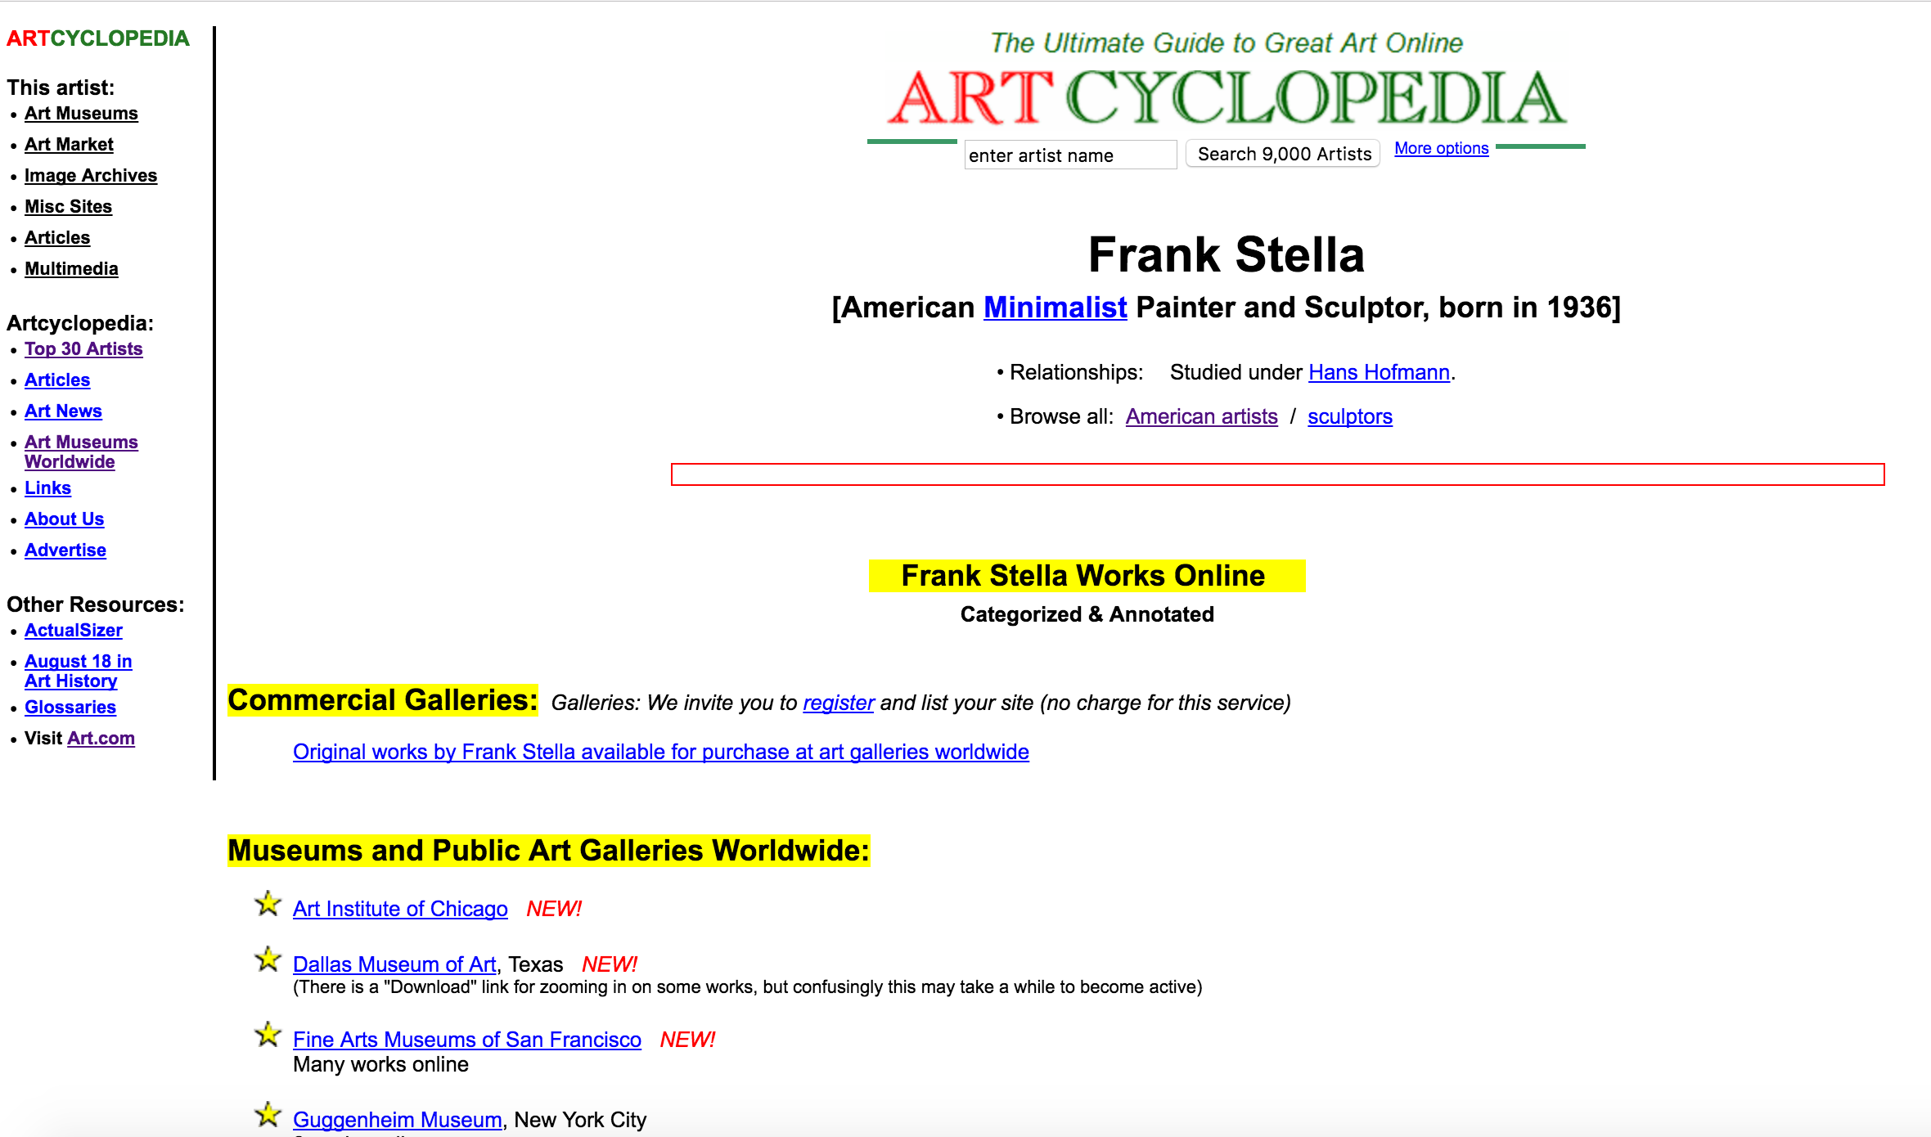
ArtCyclopedia.com

Slide 3
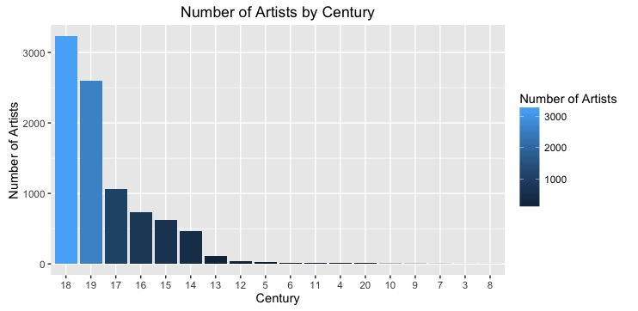
Which century contributed to us the most artists?

Slide 4
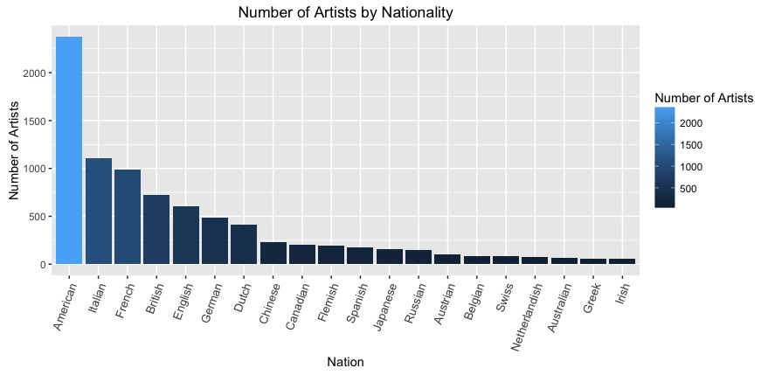
Which country contributed to us the most artists?

Slide 5
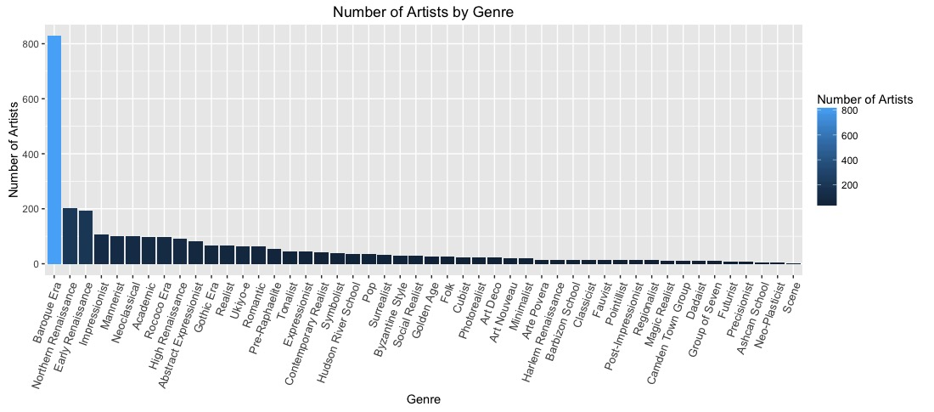
Which genre do we consider main stream?

Slide 6

Just for fun: popular artist names

Slide 7
Visualize Art History
Century vs Genre
Century vs Nationality
Nationality vs Genre

